Slide 1
Dimitris Papailiopoulos
University of Wisconsin-Madison
Inference on Deep Networks, Model Compression and Quantization

Slide 2






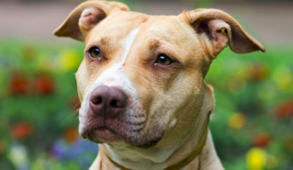
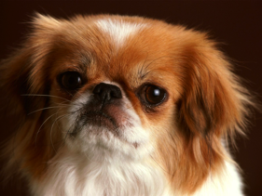

Standard ML Pipeline
Input Data

Slide 3
Standard ML Pipeline
Input Data
Training

Slide 4
Standard ML Pipeline
Input Data
Training
Model

Slide 5
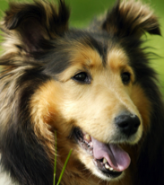
Standard ML Pipeline
This is called inference
Test (unseen) Data
Input Data
Training
Model
predicted
label:
“dog”

Slide 6
Today
Cost of Inference
Compression
Low-precision and Quantization

Slide 7
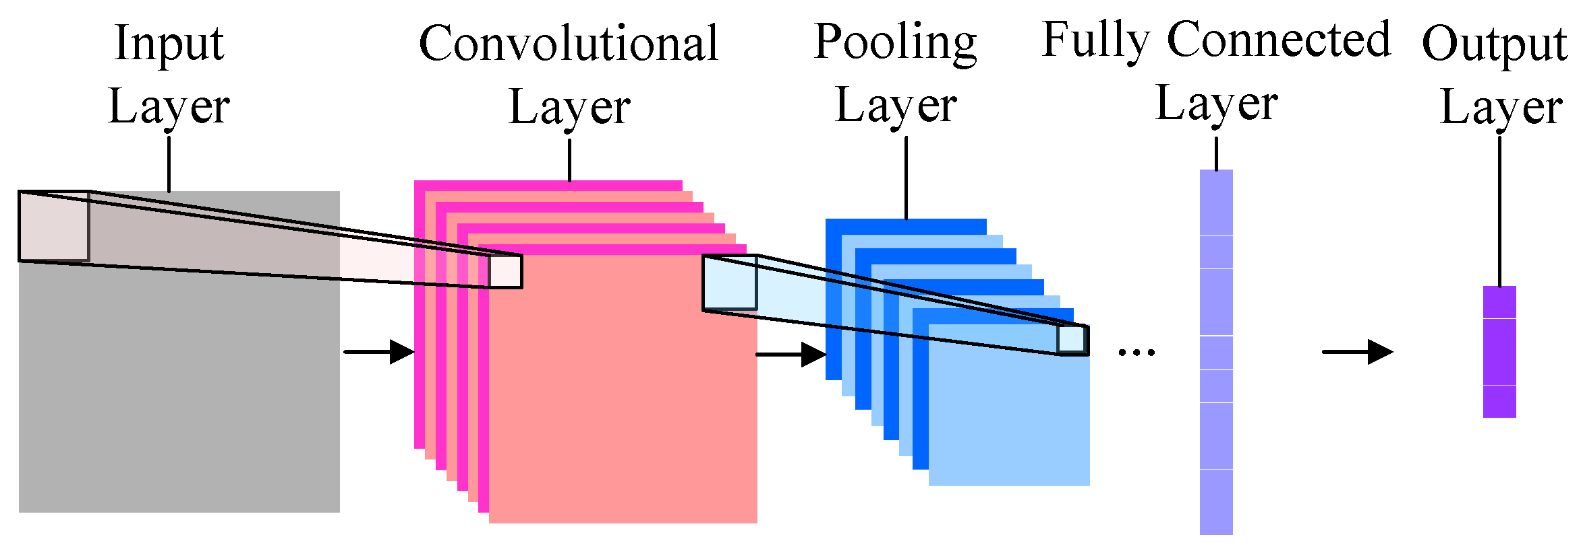
Cost of Inference
Memory: storing the model is O(#parameters)
Computation: For each input, you do a “forward pass”
2010s mantra: Deeper is Better

Slide 8
Bigger models = Better Models?
[Canziani, Culurciello, Paszke, 2016]

Slide 9
Size and Ops
ResNet-152 ~ 230 MB
[Canziani, Culurciello, Paszke, 2016]

Slide 10
Inference time
#OPS ~ Inference time
For real-time applications, inference time is important!
[Canziani, Culurciello, Paszke, 2016]

Slide 11
Tradeoffs
A Good model has to:
Have high accuracy
Be easily trainable
Be fast during inference
Be compact

Slide 12
Model Compression and Quantization

Slide 13
Deep Compression
Motivation: Large models are difficult to deploy in
resource limited setups
Three step procedure:
Prune weight, while training
Quantize weights using k-means
Compress quantized weights
[Han, Mao, Dally, ICLR 2016]

Slide 14
Deep Compression
[Han, Mao, Dally, ICLR 2016]

Slide 15
Deep Compression: Step 1
SGD
Prune |weights| < t
SGD
[Han, Mao, Dally, ICLR 2016]

Slide 16
Deep Compression: Step 2
K-means used
for clustering
[Han, Mao, Dally, ICLR 2016]

Slide 17
Deep Compression: Step 2
aka weight sharing
[Han, Mao, Dally, ICLR 2016]

Slide 18
Deep Compression: Step 3
[Han, Mao, Dally, ICLR 2016]

Slide 19
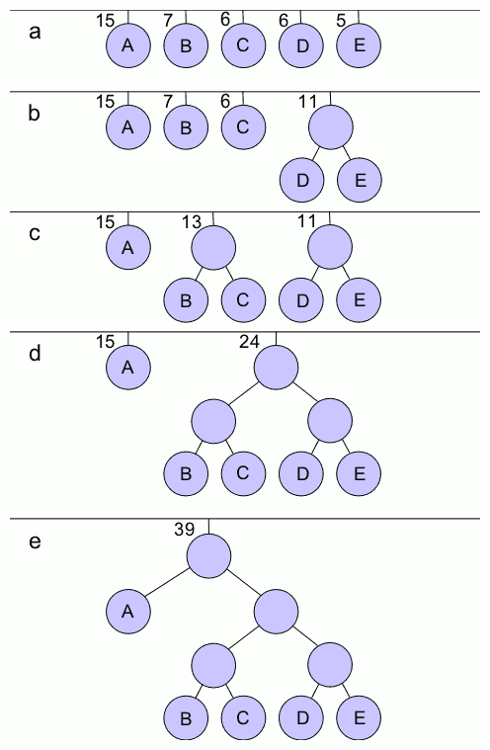
Huffman Encoding

Slide 20
Huffman Encoding

Slide 21
Huffman Encoding

Slide 22
Huffman Encoding

Slide 23
Huffman Encoding
Why Huffman?
Huffman is optimal for a
symbol-by-symbol encoding
and known symbol probabilities

Slide 24
Deep Compression
[Han, Mao, Dally, ICLR 2016]

Slide 25
Deep Compression: Experiments
[Han, Mao, Dally, ICLR 2016]

Slide 26
Deep Compression: Experiments
Pruning + quantization
is best
[Han, Mao, Dally, ICLR 2016]

Slide 27
Deep Compression: Experiments
Less ops = faster inference
[Han, Mao, Dally, ICLR 2016]

Slide 28
Deep Compression: Experiments
Less ops = less energy
[Han, Mao, Dally, ICLR 2016]

Slide 29
Deep Compression: Experiments
Quantized models
are accurate
[Han, Mao, Dally, ICLR 2016]

Slide 30
Binary ConvNets

Slide 31
XNOR-Net
Motivation:
“CNNs need large amounts of memory and computation. While they perform well on expensive, GPU-based machines, they are often unsuitable for smaller devices like cell phones and embedded electronics.”
[Rastegari, Ordonez, Redmon, Farhadi, 2016]

Slide 32
XNOR-Net
Binary-Weight-Nets: conv filters are only +1/-1
XNOR-Nets: input AND filter is binary
[Rastegari, Ordonez, Redmon, Farhadi, 2016]

Slide 33
XNOR-Net
Goal:
Find the best binary network that approximates original
We hope that
For some +1/-1 matrix B
[Rastegari, Ordonez, Redmon, Farhadi, 2016]

Slide 34
XNOR-Net
Method: for a given layer, and a given matrix, F, the best binary matrix B is given by
[Rastegari, Ordonez, Redmon, Farhadi, 2016]

Slide 35
XNOR-Net
[Rastegari, Ordonez, Redmon, Farhadi, 2016]

Slide 36
XNOR-Net
[Rastegari, Ordonez, Redmon, Farhadi, 2016]

Slide 37
XNOR-Net
[Rastegari, Ordonez, Redmon, Farhadi, 2016]

Slide 38
XNOR-Net
[Rastegari, Ordonez, Redmon, Farhadi, 2016]

Slide 39
XNOR-Net
[Rastegari, Ordonez, Redmon, Farhadi, 2016]

Slide 40
XNOR-Net
[Rastegari, Ordonez, Redmon, Farhadi, 2016]

Slide 41
XNOR-Net
Optimal solutions of
Computable in linear time
[Rastegari, Ordonez, Redmon, Farhadi, 2016]

Slide 42
BW-Net
How do we train?
Forward pass: binarize weights
Backward pass: replace grad of sign(w) function with
and follow chain rule
Parameter update: use floats
[Rastegari, Ordonez, Redmon, Farhadi, 2016]

Slide 43
XNOR-Net
How do we binarize both inputs and weights?
Similar idea as before, but a little more work to make convolution efficient
[Rastegari, Ordonez, Redmon, Farhadi, 2016]

Slide 44
XNOR-Net: Experiments
[Rastegari, Ordonez, Redmon, Farhadi, 2016]

Slide 45
XNOR-Net: Experiments
[Rastegari, Ordonez, Redmon, Farhadi, 2016]

Slide 46
XNOR-Net: Experiments
TL;DR ~30x speedup and less memory
Makes deep nets more suitable for mobile devices
[Rastegari, Ordonez, Redmon, Farhadi, 2016]

Slide 47
Remarks
Several interesting papers on model quantization and compression, especially for edge devices/low-power HW
Low-rank factorization
Training quantization levels
SqueezeNets/MobileNets/Ternary Nets/ShuffleNet
Which one is best?
Theory for pruned/quantized nets?
how many weights can I throw away before I incure an error ε?
Use of expanders?
Sparse approximation theory?
Matrix Sketching?

Slide 48
Next time

Slide 49
The end

